Slide 1

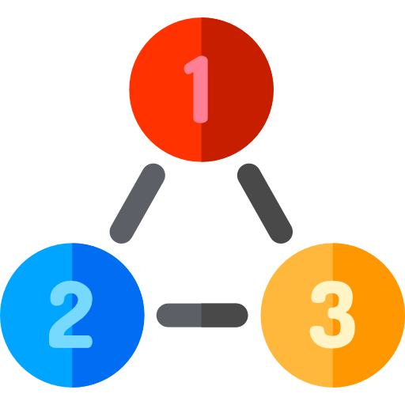
MVC(Model-View- Controller)
Notes:
Hello Everyone,Welcome to Aitrich Accademy….Today we are discussing about the topic MVC That is Model View Conteroller. a fundamental concept in software architecture

Slide 2


What is MVC?
MVC (Model-View-Controller) design pattern was introduced in the 1970s which divides an application into 3 major components. They are Model, View, and Controller.​
MVC stands for Model View and Controller.
It is an architectural design pattern that means this design pattern is used at the architecture level of an application.
MVC is not a Framework, it is a design pattern.
Notes:
What is MVC?
MVC was introduced in the 1970s and has since become a cornerstone in organizing and developing robust and scalable applications It is architectural pattern aims to separate an application into three interconnected components, each handling a specific set of responsibilities. It stands for Model, View, and Controller. MVC (Model-View-Controller) is indeed an architectural design pattern used at the architectural level of an application. It defines a high-level structure for separating the presentation (view), data (model), and business logic (controller) of an application, aiming to improve the organization, maintainability, and testability of code. MVC is not a ready-made tool but more like a blueprint for structuring code.MVC is not a Framework, it is a design pattern.

Slide 3

What is ASP.NET Core MVC?
The ASP.NET Core MVC is a lightweight, open-source, highly testable presentation framework that is used for building web apps and Web APIs using the Model-View-Controller (MVC) design pattern.
MVC is a design pattern and ASP.NET Core MVC is the framework that is based on MVC Design Pattern.
It also supports for Test-Driven Development and also uses the latest web standards.
Notes:
What is A.S.P dot NET Core.Let's talk about A.S.P dot NET Core MVC..a lightweight, open-source, and highly testable presentation framework that plays a pivotal role in developing web applications..A.S.P dot NET Core MVC is lightweight, meaning it's designed to be fast and efficient without unnecessary complexities.. Being open source, it allows developers to dive into the source code, customize, and contribute to its ongoing development,The framework is highly testable, making it easier for developers to ensure the reliability and functionality of their code. MVC is a design pattern, and A.S.P dot NET MVC is a framework built upon this pattern to streamline web application development.In shortly A.S.P dot NET MVC is a robust framework for building dynamic, scalable, and cross-platform web applications. Its adherence to the MVC pattern and integration with A.S.P dot NET make it a compelling choice for developers. MVC is a design pattern, and A.S.P dot NET Core MVC is the framework that brings this pattern to life, offering developers a structured and efficient way to build web applications

Slide 4
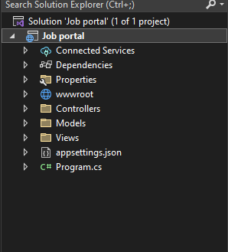
How to Set up MVC Application in ASP.NET Core
Create New Project
Configure your new project
Addition information
Notes:
How to Set up MVC Application in ASP.NET Core
Here, we're going to embark on a journey to create a web application using ASP.NET Core MVC. The first step is to ensure you have the necessary tools installed. You'll need Visual Studio. You can download them from the official Microsoft website. Open Visual Studio, select 'Create a new project,' and choose the ASP.NET Core Web App(Model-View-Controller) template. Once the project is created, let's take a look at the project structure. Notice the folders like 'Controllers,' 'Views,' and 'Models' – these align with the MVC pattern.

Slide 5
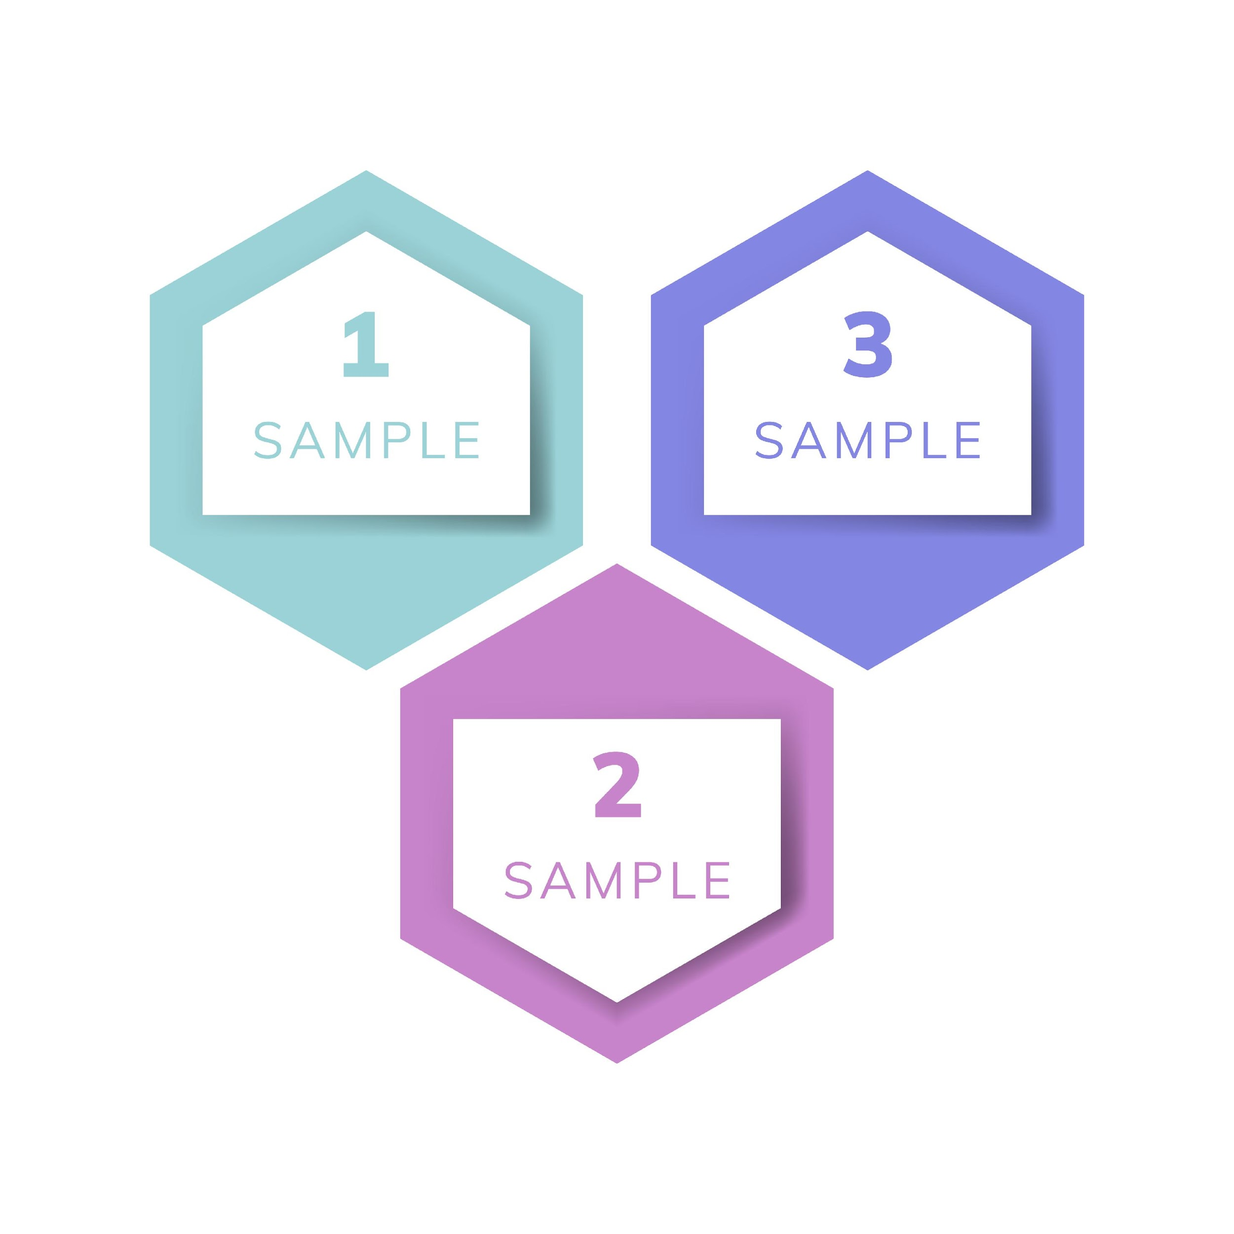
COMPONENTS OF MVC
Model: A set of classes that describes the data you are working with as well as the business logic.​
Model: A set of classes that describes the data you are working with as well as the business logic.​
Controller:A set of classes that handles communication from the user, overall application flow, and application-specific logic.​
View: Defines how the application’s UI will be displayed. It is a pure HTML, which decides how the UI is going to look like.​
Notes:
+COMPONENTS OF MVC
We are already discussed that The MVC (Model-View-Controller) architectural pattern divides an application into three interconnected components to separate the concerns and provide a clean structure. Here are the key components of MVC
Model
The set of classes that describes the data and encapsulates the business logic in a software application is commonly referred to as the "Model"
The Model represents the application's data and business logic.
It is responsible for retrieving, storing, and processing data.
Changes in the data trigger notifications to update the View.
View:
The View is concerned with the visual representation of the data and the overall look and feel of the application.
Presents data to the user.
Receives data from the Model for display.
Typically, multiple views can represent the same data differently.
Controller:
It acts as an intermediary between the Model and the View, receiving user input from the View, processing it, and updating the Model and View accordingly
In detail we will discuss in coming slides
Handles user input.
Invokes actions in the Model based on user interactions.
Updates the View based on changes in the Model.

Slide 6
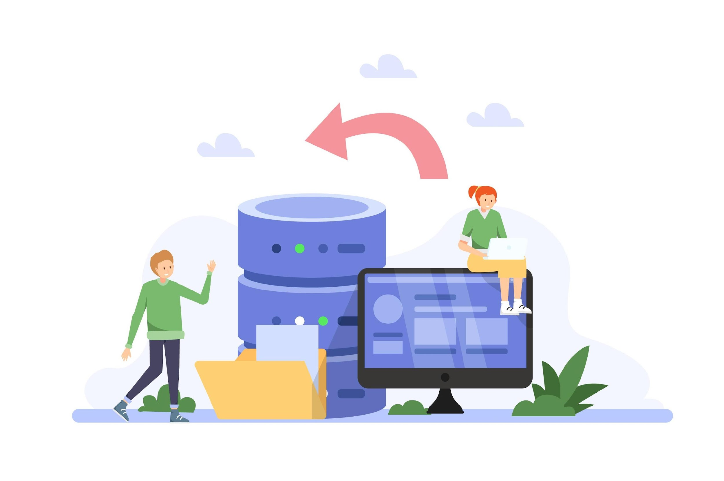
Model
A model is a class with .cs (for C#) as an extension having both properties and methods.
Models are used to set or get the data.
If your application does not have data, then there is no need for a model.
models in ASP.NET Core MVC Application are used to manage the data i.e. the state of the application in memory.
Notes:
let's dive into the heart of our ASP.NET Core MVC application: the Models . These are the classes responsible for managing our application's data and state. In ASP.NET Core MVC, a Model is essentially a class, often with a '.cs' extension. This class encapsulates both properties and methods, serving as a blueprint for managing data in our application . Models play a crucial role in setting or getting data within our application.They act as containers for both the structure (properties) and behavior (methods) related to our data. Do We Always Need a Model? It's important to note that if our application doesn't involve data, there might not be a need for a model. Models are particularly valuable when dealing with entities or objects that have properties and behavior. Beyond data, Models are instrumental in managing the state of our application in memory.This means they keep track of changes, updates, and ensure that the application's data remains consistent across different parts of our application.

Slide 7
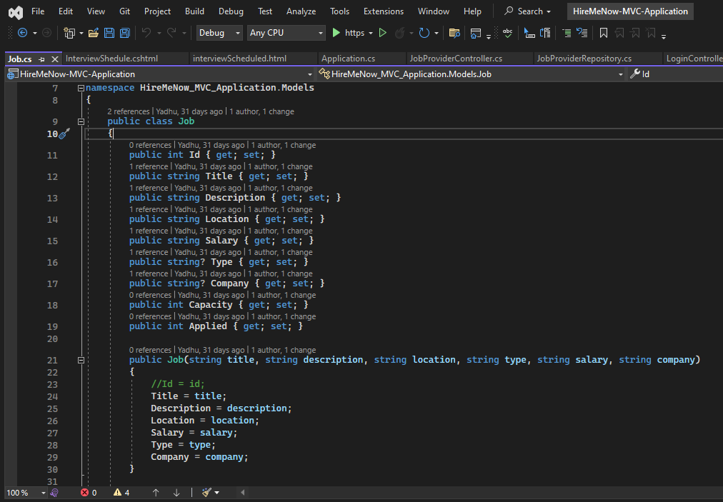
Notes:
Here is the example of Model
The Model Name is Job…Id,Tiitle,Description,Location,Salary,Type,Company,Capacity,Applied are attributes. Each of these lines defines a property within a class, and each property represents an attribute of a job posting. These properties provide controlled access to the attributes, allowing other parts of the program to read and modify them as needed.

Slide 8
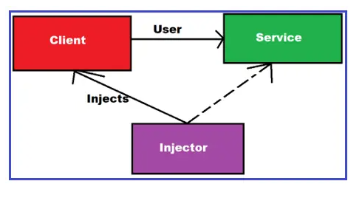
ASP.NET Core Dependency Injection
process of injecting the object of a class into a class that depends on it.
The Dependency Injection is the most commonly used design pattern nowadays to the dependencies between the objects that allow us to develop loosely coupled software components.
Notes:
ASP.NET Core Dependency Injection
SP.NET Core Dependency Injection (DI) is a built-in feature that allows you to implement inversion of control (IoC) in your applications. In simpler terms, it helps manage the dependencies between various components of your application.
The process of injecting an object of a class into another class that depends on it is called Dependency Injection (DI). In DI, the dependent class doesn't create instances of its dependencies itself; instead, it receives them from an external source, typically a Dependency Injection container.
Absolutely, you're spot on! Dependency Injection (DI) is indeed one of the most commonly used design patterns in modern software development, especially in frameworks like ASP.NET Core, Spring Framework for Java, and many others. It's a fundamental principle of building loosely coupled and highly maintainable software components.

Slide 9
Types of Services in ASP.NET Core:
In order to let the IoC container automatically inject our application services, we first need to register them with the IoC container
Framework Services:Services that are a part of the ASP.NET Core framework such as IApplicationBuilder, IHostingEnvironment, ILoggerFactory, etc.
Application Services: The services (custom types or classes) which you as a programmer create for your application.
Notes:
In ASP.NET Core, services can be categorized into two main types: application services and framework services
Framework Services:
Framework services are built-in services provided by the ASP.NET Core framework to support common infrastructure and functionality required for web applications. These services are provided by ASP.NET Core itself or by third-party libraries and packages that are commonly used in ASP.NET Core applications.
Application Services:
Application services are the services that you create or define within your application to support its specific functionality and requirements. Application services are registered with the dependency injection (DI) container during application startup and are used throughout your application to implement its features.
In traditional programming, you directly instantiate objects and manage their lifecycles throughout your application. For example, if a class needs to use another class, it typically creates an instance of that class itself using the new keyword.
Inversion of Control (IoC): With IoC, this control is inverted. Instead of classes directly creating instances of their dependencies, they rely on an external entity (such as a DI container) to provide those dependencies. This external entity is responsible for managing the instantiation, lifetime, and configuration of objects.
Dependency Injection (DI): DI is a specific implementation of IoC. It involves injecting dependencies into a class rather than having the class create them itself. This makes classes more modular, reusable, and easier to test.

Slide 10
How to register a Service with ASP.NET Core Dependency Injection Container?
We need to register a service with ASP.NET Core Dependency Injection Container within the ConfigureServices() method of the Startup class.
Singleton: In this case, the IoC container will create and share a single instance of a service object throughout the application’s lifetime.
Singleton: In this case, the IoC container will create and share a single instance of a service object throughout the application’s lifetime.
Transient: In this case, the IoC container will create a new instance of the specified service type every time you ask for it.
Scoped: In this case, the IoC container will create an instance of the specified service type once per request and will be shared in a single request.
Notes:
How to register a Service with ASP.NET Core Dependency Injection Container?
Absolutely! Registering a service with the ASP.NET Core Dependency Injection (DI) container is typically done within the ConfigureServices() method of the Startup class. This method is called during application startup and is responsible for configuring services for the DI container.

Slide 11
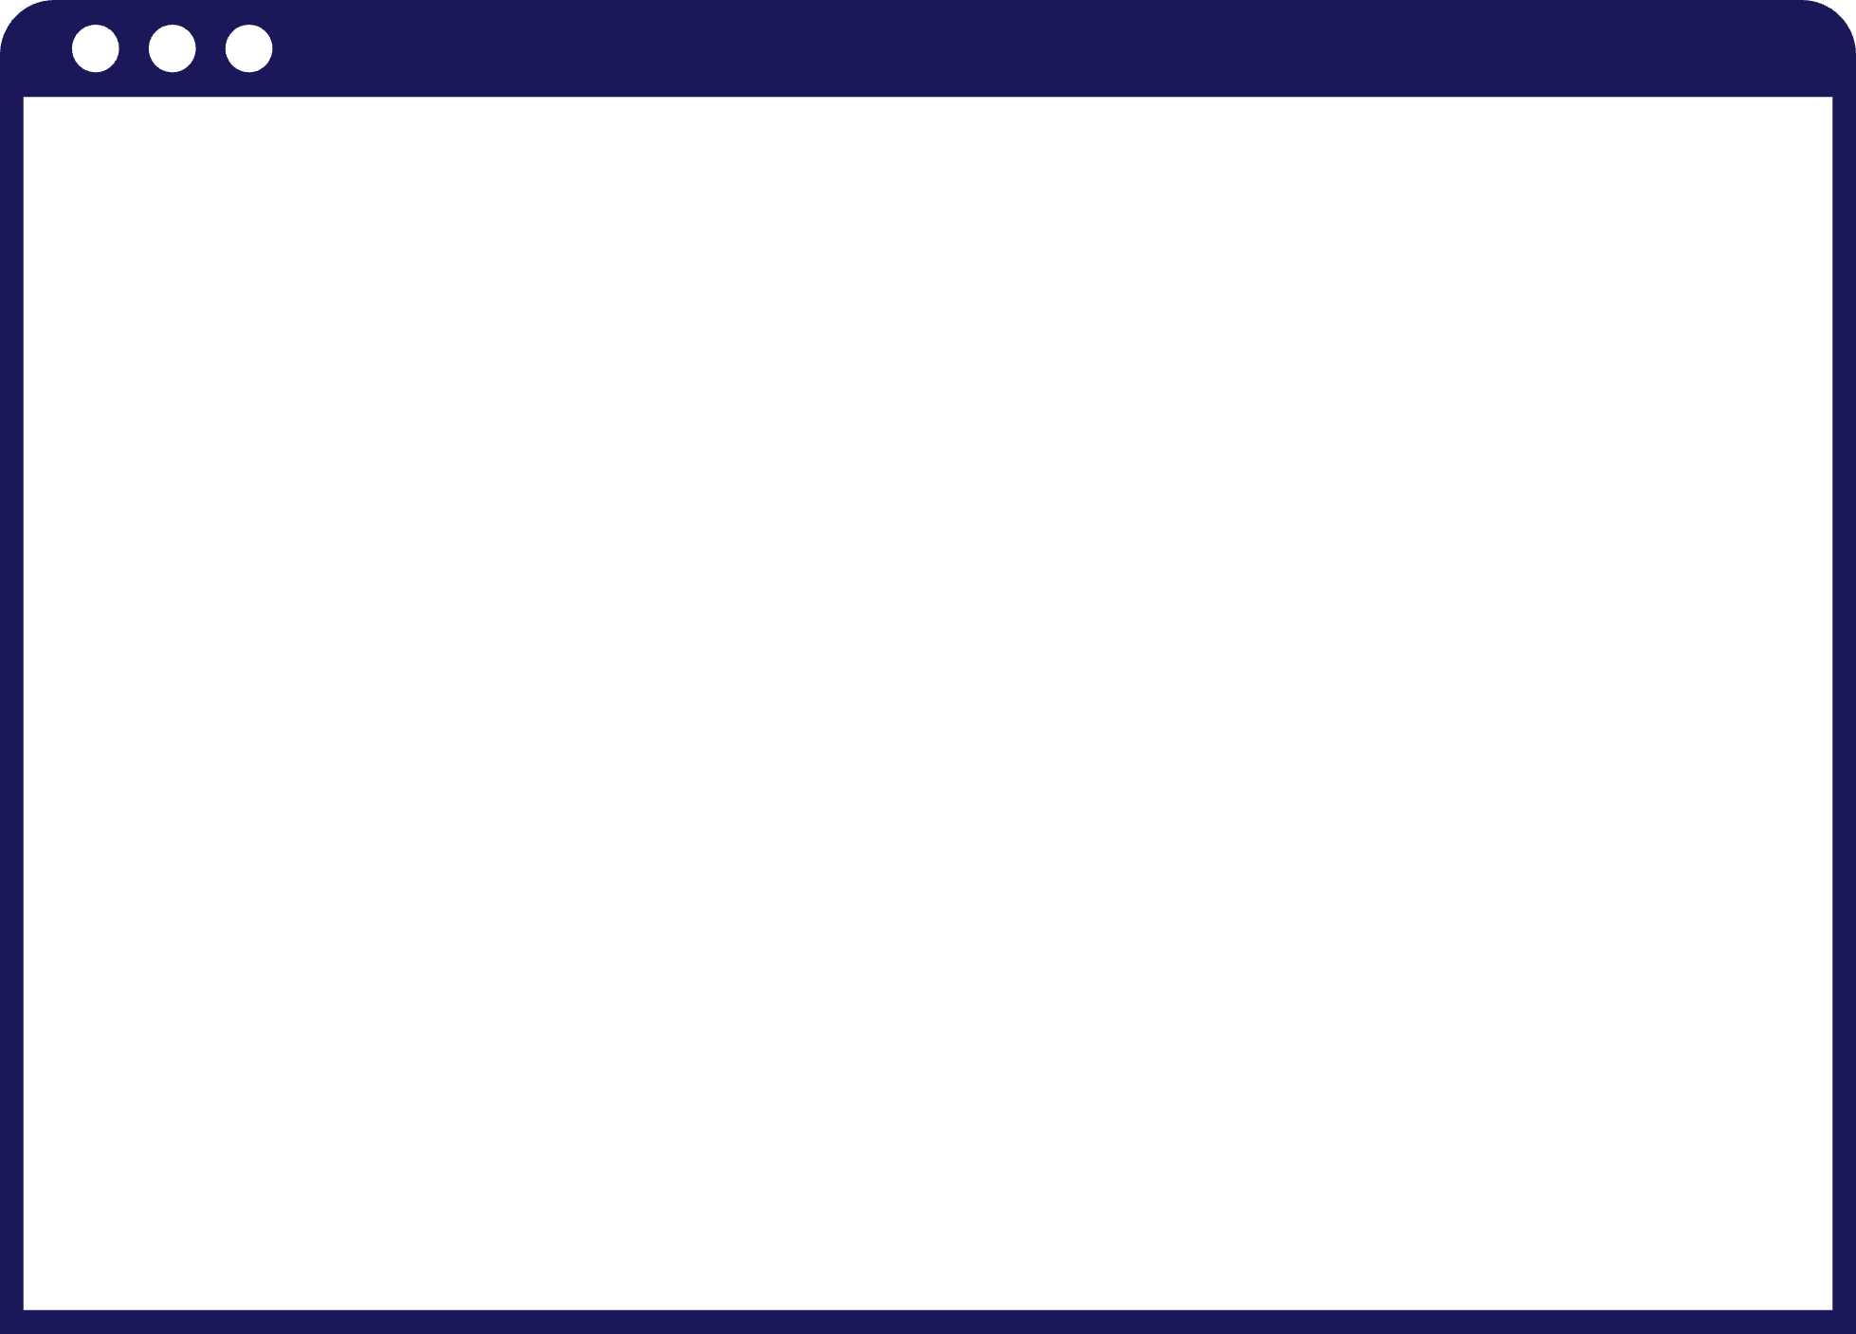
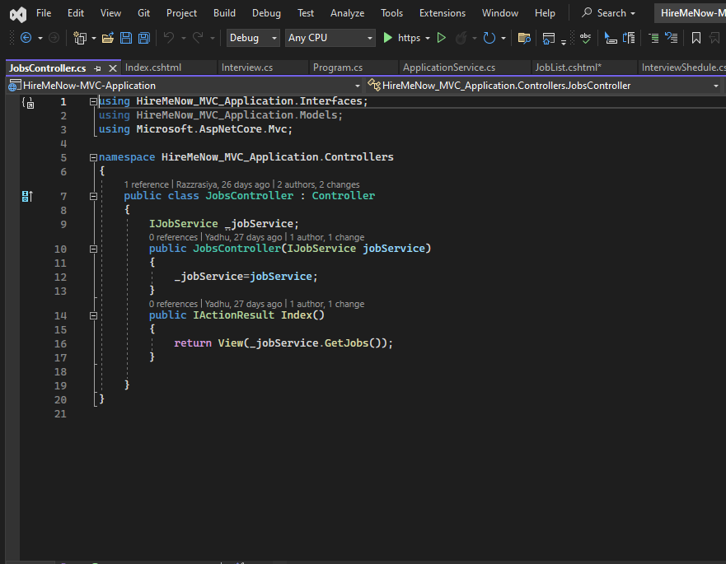
Controller
A Controller is a .cs (for C# language) file which has some methods called Action Methods.
When a request comes on the controller, it is the action method of the controller which will handle those requests.
Controller (RightClick) New Controller
Notes:
Controller
Controllers typically reside within the Controllers folder of your ASP.NET Core project. Controllers inherit from the Controller or ControllerBase class provided by ASP.NET Core.
Certainly! In ASP.NET Core, controllers are responsible for handling incoming HTTP requests, processing the requests, and generating appropriate responses. Controllers is a class typically contain action methods that correspond to different HTTP endpoints, such as routes defined in the application. Action methods within controllers handle specific HTTP requests.

Slide 12
Action methods within controllers handle specific HTTP requests.
ASP.NET Core uses routing to map incoming requests to the appropriate controller and action method..
Routing
Action Methods
Attributes are used to decorate action methods and define additional metadata such as route templates, HTTP verbs, and action filters..
Action
Action Methods returns an Action Result or its derived types to generate response.
Attributes
ActionResult
Notes:
4 nmain things under Controller is
Action Methods
Action methods within controllers handle specific HTTP requests.
Each action method corresponds to a particular HTTP verb (e.g., GET, POST) and route.
Action methods return an ActionResult or one of its derived types to generate an HTTP response.
Routing
ASP.NET Core uses routing to map incoming requests to the appropriate controller and action method.
Routes are typically configured in the Startup class using the UseEndpoints method.
Attributes
Attributes are used to decorate action methods and define additional metadata such as route templates, HTTP verbs, and action filters.
Commonly used attributes include [HttpGet], [HttpPost], [Route], [Authorize], etc.
ActionResult
Action methods return an ActionResult or its derived types to generate responses.
ActionResult represents the result of an action method execution, which can be a view, a redirect, a JSON object, or any other HTTP response.

Slide 13
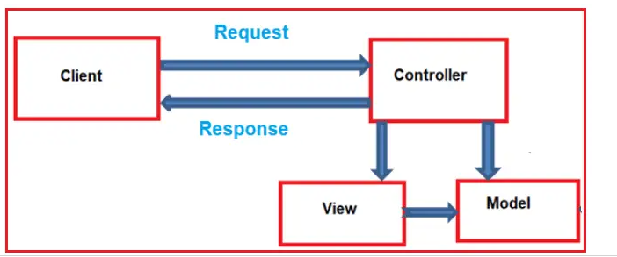
When the client (browser) sends a request to the server, then that request first goes through the request processing pipeline. Once the request passes the request processing pipeline, it will hit the controller. Inside the controller, there are lots of methods (called action methods) actually handle that incoming HTTP Request. The action method inside the controller executes the business logic and prepared the response which is sent back to the client who initially made the request.
When the client (browser) sends a request to the server, then that request first goes through the request processing pipeline. Once the request passes the request processing pipeline, it will hit the controller. Inside the controller, there are lots of methods (called action methods) actually handle that incoming HTTP Request. The action method inside the controller executes the business logic and prepared the response which is sent back to the client who initially made the request.
Notes:
The Workflow in Controller is like this
When a client, such as a browser, sends a request to the server, it first traverses through the request processing pipeline. This pipeline consists of a series of middleware components configured in the application's startup class.Once the request passes through the request processing pipeline, it reaches the controller. Inside the controller, there are various action methods, each designed to handle a specific type of incoming HTTP request. These action methods are responsible for executing the business logic associated with the request and preparing the response to be sent back to the client.The controller's action method processes the request by interacting with services, repositories, and other components as needed. It may perform tasks such as querying a database, validating user input, or invoking external APIs.Once the action method has completed its execution, it returns an instance of IActionResult or one of its derived types. This result represents the response to be sent back to the client.Finally, the response is returned to the client, completing the request-response cycle. The client receives the response and processes it accordingly, whether it's rendering a web page, displaying data, or handling errors.

Slide 14

What are Action Methods?
All the public methods of a controller class are known as Action Methods.
An action method can return several types.
When we get an HTTP Request on a Controller, it is actually the controller action method getting that call.
The default structure is:http://domain.com/Home/Index
Notes:
What are Action Methods? Action methods are public methods defined within controllers in ASP.NET Core applications that handle incoming HTTP requests. These methods contain the logic to process the request, perform necessary operations, and prepare the response to be sent back to the client. Absolutely, action methods in ASP.NET Core can return various types of results, depending on the requirements of the application and the nature of the HTTP request being handled. Here are some common types that action methods can returns are ViewResult, RedirectResult, JsonResult, ContentResult,FileResult, StatusCodeResult, ActionResult. when an HTTP request is made to the server, it is typically routed to a specific controller and action method based on the request URL. The default routing convention in ASP.NET Core follows the structure,here the example http://domain.com/Home/Index would route to the Index action method of the HomeController

Slide 15

Views in ASP.NET Core MVC
views represent the presentation layer of the application
In the Model-View-Controller (MVC) pattern, the View is the component that contains logic to represent the model data (the model data provided to it by a controller) as a user interface with which the end-user can interact.
Notes:
Views in ASP.NET Core MVC
In ASP.NET Core, views are an integral part of the MVC pattern that is presentation layer and are responsible for rendering the HTML markup that is returned to the client's browser. They are responsible for displaying the user interface and presenting data to the user.Views typically contain a mixture of HTML markup and embedded code that is used to dynamically generate the content based on the data passed to them from the controller.Views are typically stored as template files with the .cshtml extension. These files can contain HTML markup as well as embedded C# code using Razor syntax. They do not contain business logic or data manipulation code; instead, they interact with the model provided by the controller to display data to the user in a meaningful way. Views can also include layout files to provide a consistent look and feel across multiple pages.

Slide 16
Basic overview of how views work in ASP.NET Core
The Views in MVC are HTML templates with embedded Razor mark-up which generate content that sends to the client.
View Templates
Razor Syntax
Data Passing
Layouts
View Components
View Rendering:
Views are returned from the controller Action Method
Notes:
View Templates
Views are typically stored as template files with the .cshtml extension. These files can contain HTML markup as well as embedded C# code using Razor syntax
Razor Syntax
Razor is a markup syntax that enables you to embed server-side C# code directly into your HTML markup. This allows you to dynamically generate content based on the data provided by the controller
Data Passing
Views receive data from the controller in the form of a model. This model is typically passed to the view when it is rendered, and you can access the properties of the model within the view using Razor syntax
Layouts: ASP.NET Core allows you to define layout files that contain common HTML markup, such as headers, footers, and navigation bars. Views can then inherit from these layout files, allowing you to reuse common markup across multiple views
View Components: View components are similar to partial views in previous versions of ASP.NET MVC. They allow you to encapsulate reusable sections of markup and logic into separate components that can be reused across multiple views
View Rendering: Views are rendered by the ASP.NET Core runtime when an HTTP request is made to the corresponding controller action. The output of the view is then sent back to the client's browser as the response to the request
Overall, views in ASP.NET Core provide a powerful mechanism for generating dynamic HTML content based on the data provided by the controller, while also allowing for the reuse of common markup and logic across multiple views

Slide 17
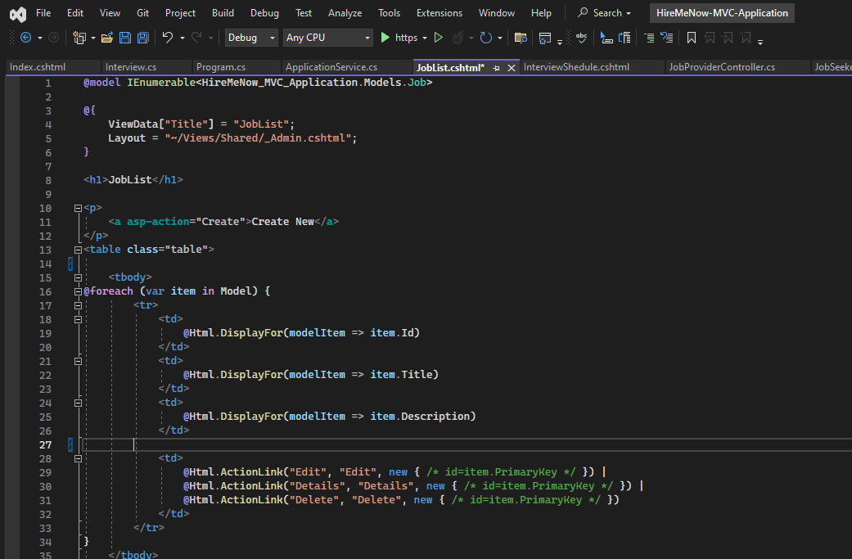
Notes:
Here is the example of View.Here The common layout used is admin layout..Model used is Job.Here Job is iterating using foreach loop..

Slide 18
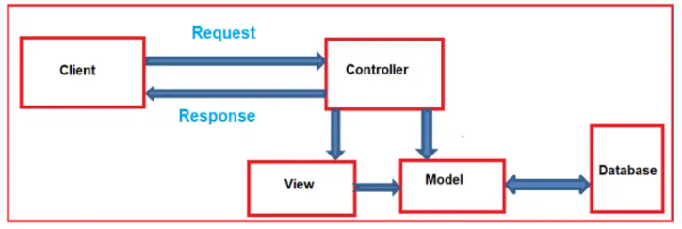
How does MVC Design Pattern work in ASP.NET Core?
Controler Handles the incoming request.
Controller component creates the model that is required by a view .
Once the model created by the controller, then the controller selects a view to render the domain data or model data.
While selecting a view, it is also the responsibility of the controller to pass the model data.
View generates the necessary HTML render the model data.
Once the HTML is generated the view is send to the client through the network
Notes:
How does MVC Design Pattern work in
Here's a breakdown of each step:ASP.NET Core.
Controller Handles Incoming Request: The process begins when an HTTP request is received by the ASP.NET Core application. The request is routed to the appropriate controller based on the URL and HTTP verb.
Controller Creates Model: The controller component is responsible for handling the request, processing any data if necessary, and creating the model that will be passed to the view. This model typically contains the data that the view needs to render.
Controller Selects View: Once the model is created, the controller selects the appropriate view to render. This selection is typically based on the action method being executed and the naming conventions used in ASP.NET Core.
Controller Passes Model Data to View: Before rendering the view, the controller passes the model data to the view. This allows the view to access and display the data to the user.
View Generates HTML: The view is responsible for generating the HTML markup that will be sent to the client's browser. Views in ASP.NET Core are typically written using Razor syntax, which allows for embedding C# code to dynamically generate HTML based on the model data.
HTML Sent to Client: Once the HTML markup is generated, it is sent to the client's browser over the network as part of the HTTP response. The browser then renders the HTML, displaying the web page to the user
This process repeats for each incoming request, with the controller handling the request, creating the model, selecting the view, passing data to the view, and finally rendering the HTML to be sent back to the client

Slide 19
